Slide 1
From Callback Hell to Async Heaven – Promises!
A Play in Three Acts: Setup, Confrontation, and Resolution

Slide 2
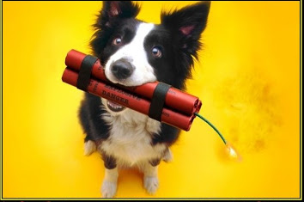
The Road To Hell Is Paved With Good Intentions
Act I: Setup

Slide 3
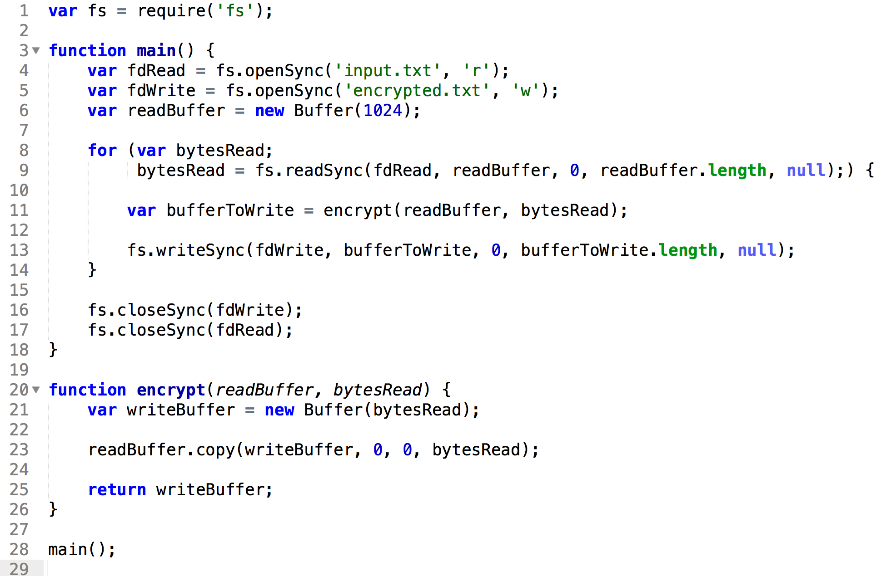
Our Journey Begins

Slide 4
Focusing on the Main Code

Slide 5


The Good and the Bad
Holds the Thread!
Not Async!
Simple
Readable
Debuggable

Slide 6

So How Do we Release The THREAD?

Slide 7
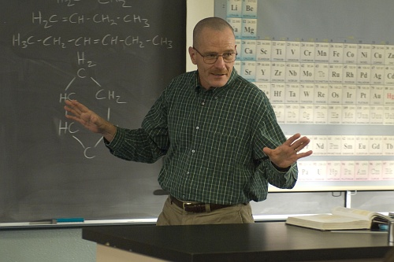
Callbacks
Good Intentions

Slide 8
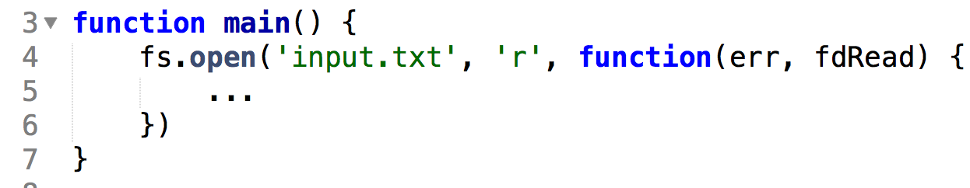
Looks Good…

Slide 9
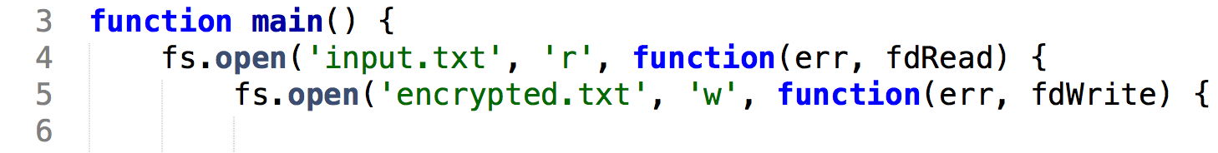
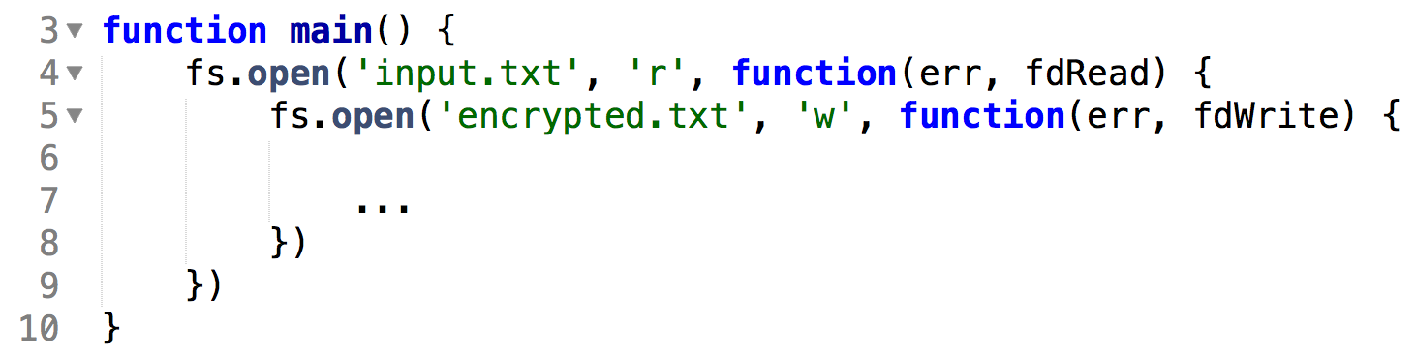

Doesn’t Look to Bad…

Slide 10
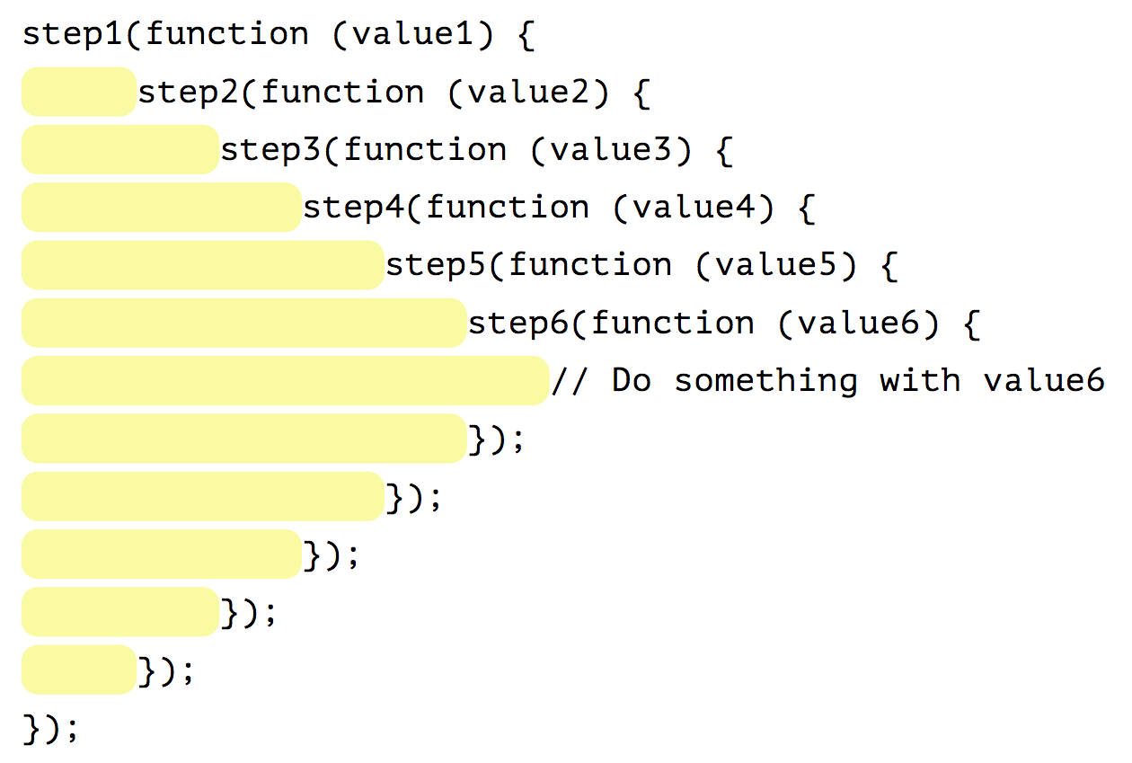
The Pyramid of Doom!
Or As I Call It…

Slide 11

The Pit of Despair!

Slide 12
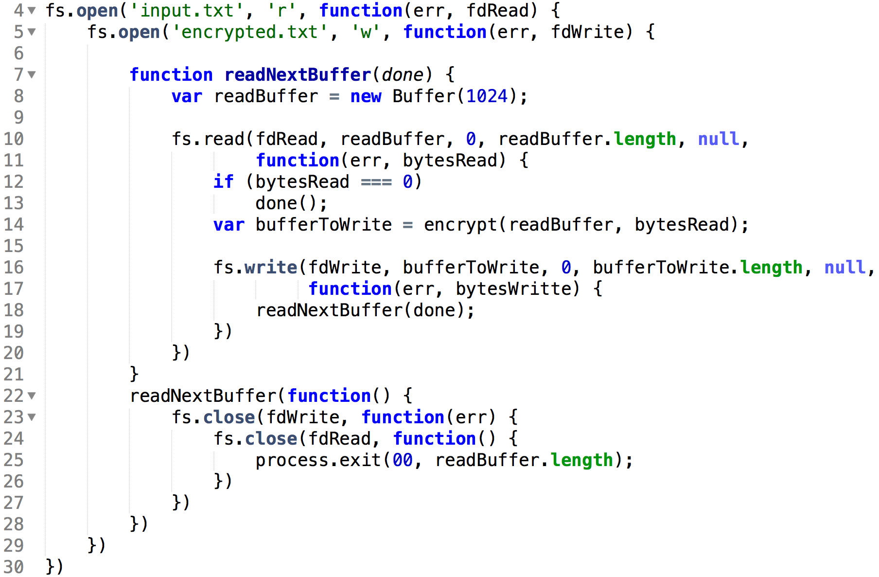
Callback Hell
In Callback Hell
There Are No Loops!

Slide 13

But I Promise – It Gets Better
Act III: Confrontation

Slide 14
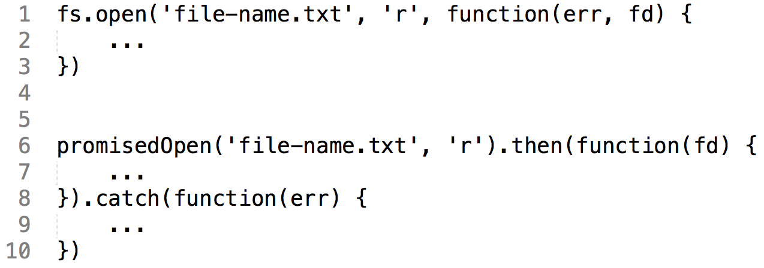
Promises Instead of Callbacks

Slide 15
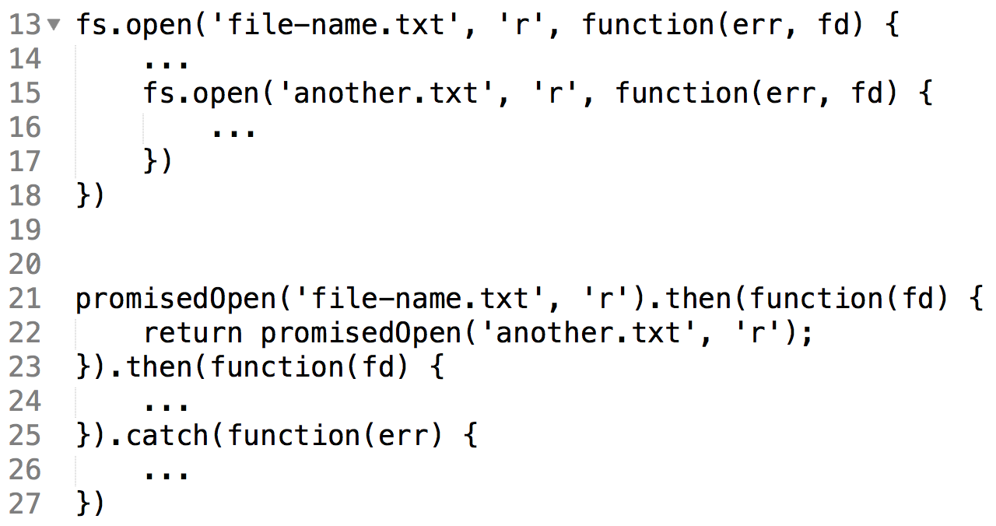
Chaining Promises
The Pit of Despair - Solved!

Slide 16
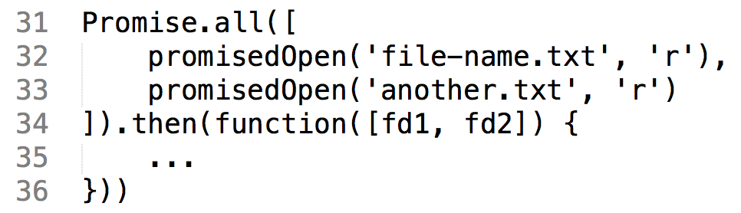
Easy Concurrency
ES6!

Slide 17
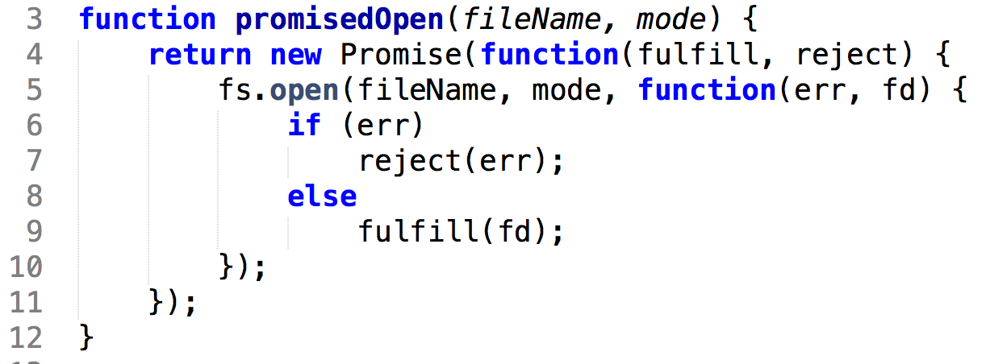
So How Do We Write promisedOpen?

Slide 18

Yes, But How do Promises Work?
I don’t know
And if I try to understand, my head hurts
I just learn to accept it

Slide 19
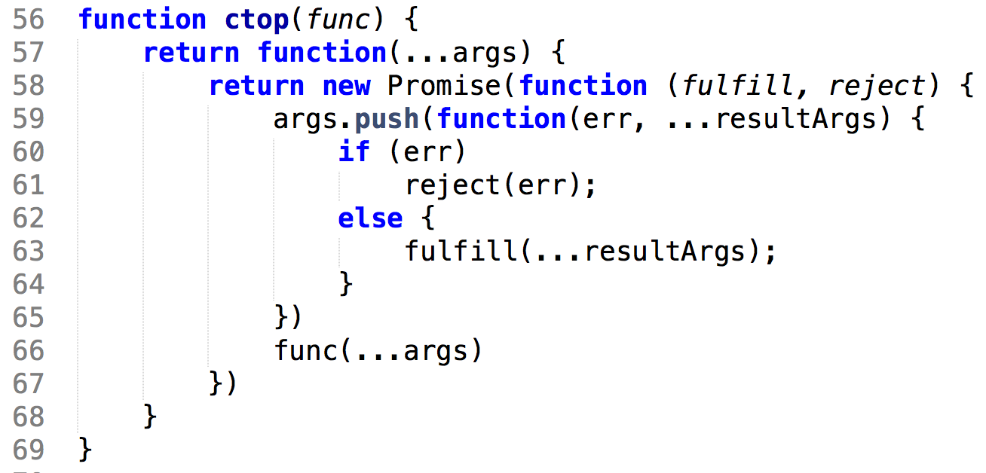
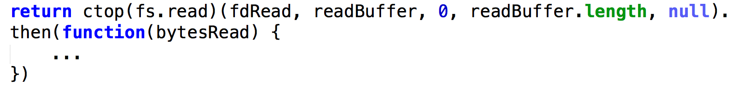
Generalizing promisedOpen Across All Node Functions
ES6!

Slide 20
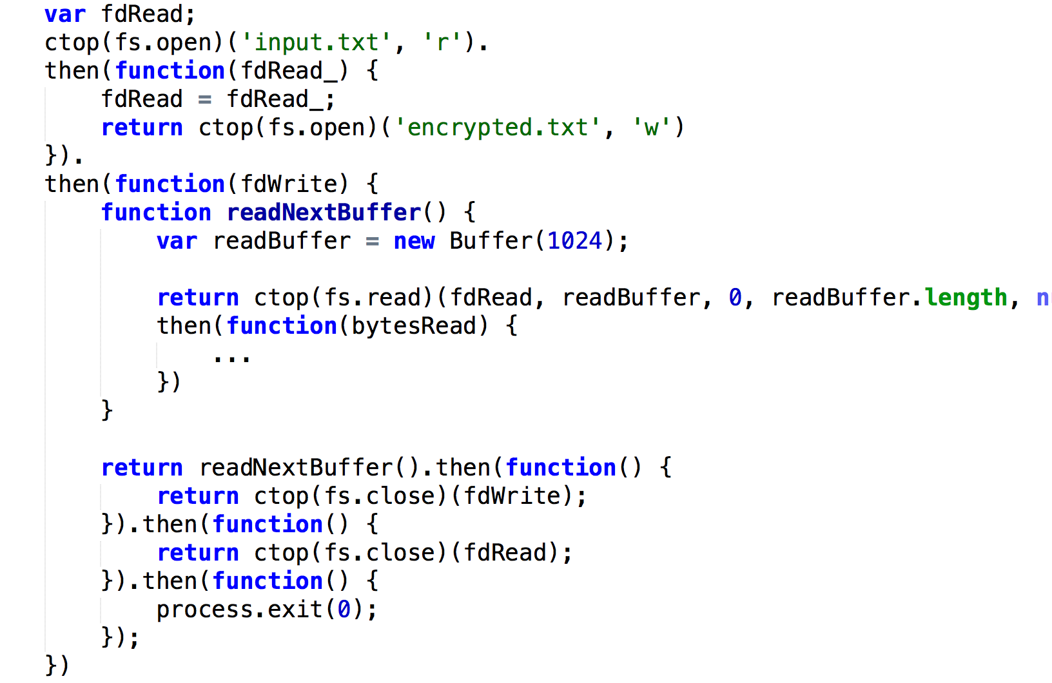
So Where Does This Take Us?
Ugh…
We Were Promised Heaven
But Are Still In Hell!
Still no loop

Slide 21

Promises Must Be Kept – Onward To Async Heaven!
Act III: Resolution

Slide 22
But Let’s Yield To A Little Detour

Slide 23
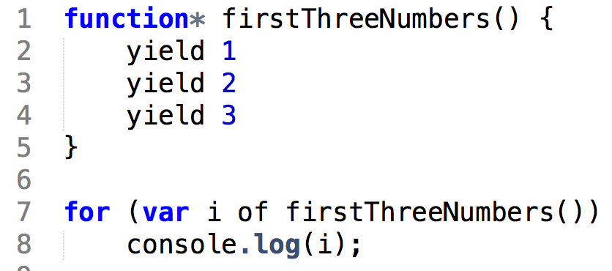
Generator Functions
Only ES6!

Slide 24
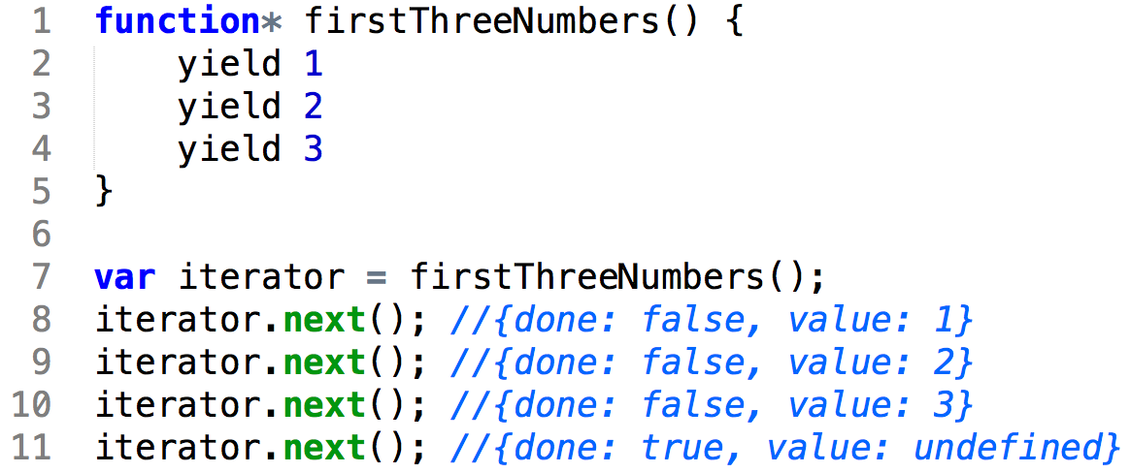
Iterator Protocol

Slide 25
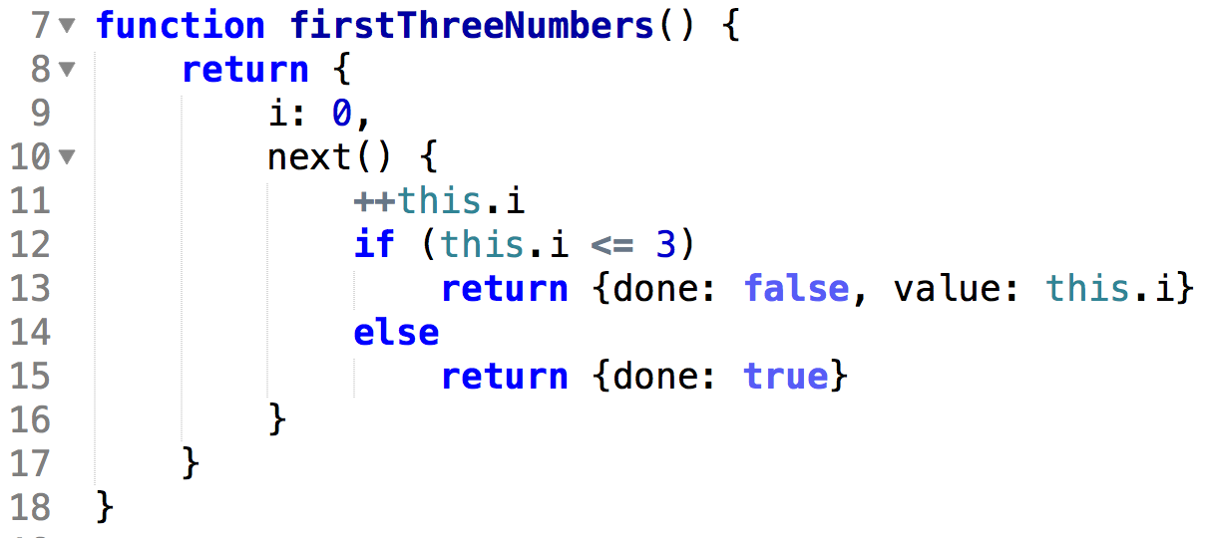
We could have done it like this…
ES6!

Slide 26
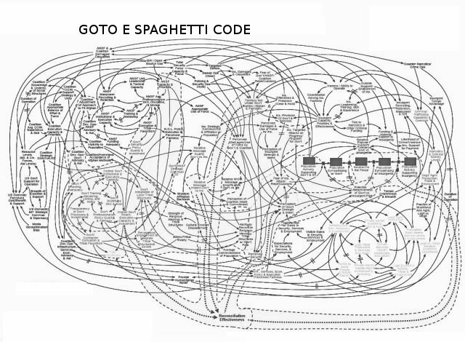
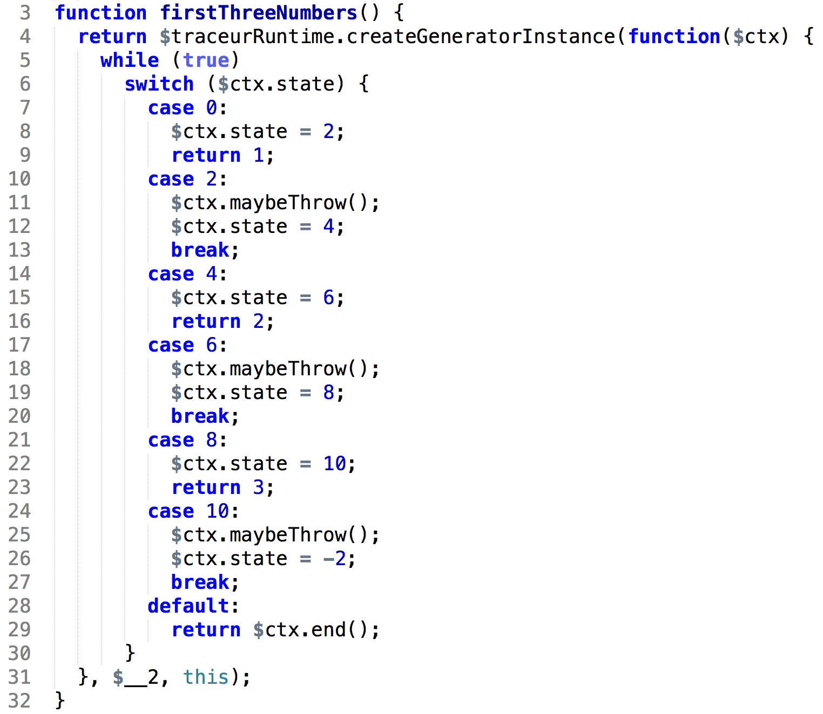
But the ES6 compiler does it like this…
Just Don’t Think About it!

Slide 27
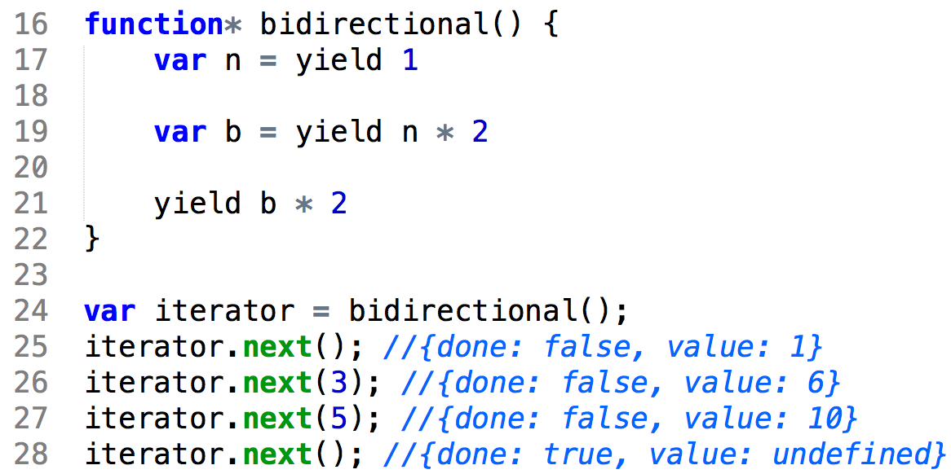
Bi-Directional Protocol
Co-Routines

Slide 28

This Is Where It Becomes Mind-Boggling

Slide 29
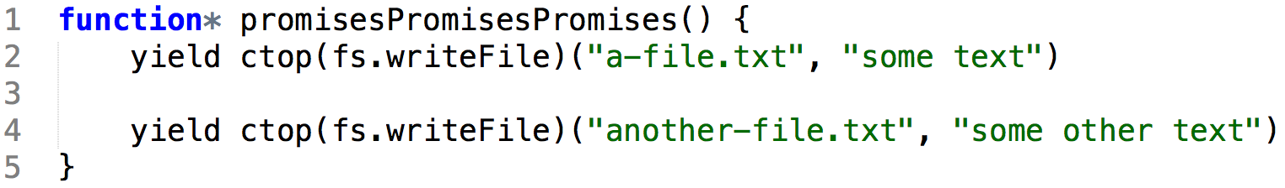
Can We Fulfill The Promise?

Slide 30
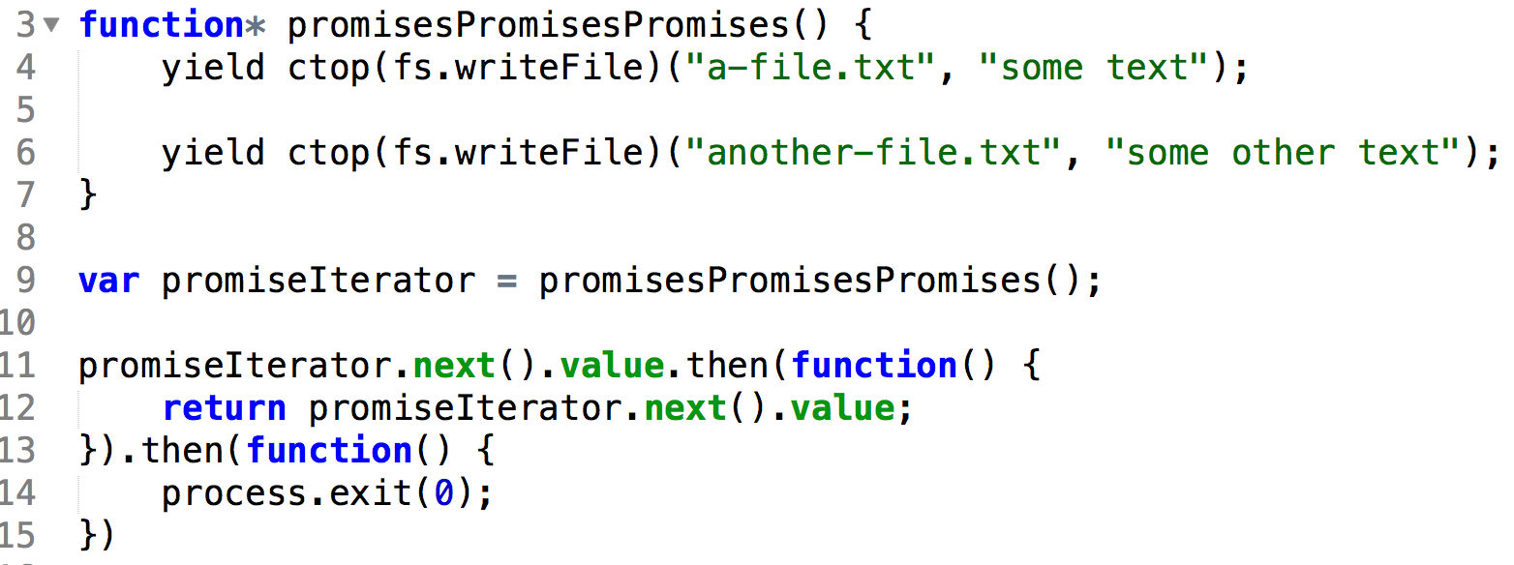
Sure!

Slide 31
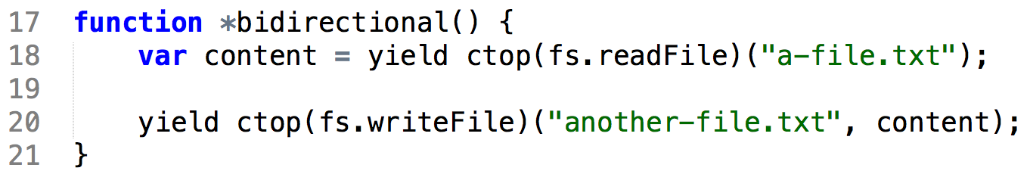
So What About This?

Slide 32
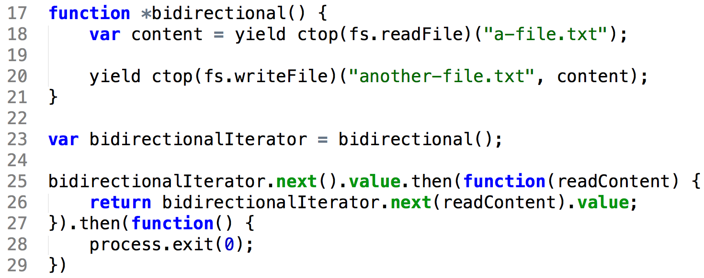
No Problem!

Slide 33
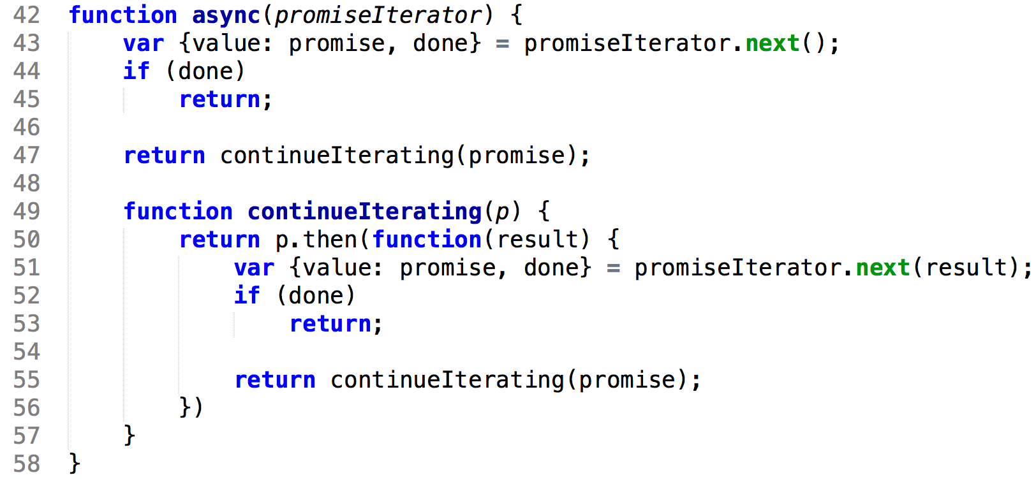
Let’s Generalize

Slide 34
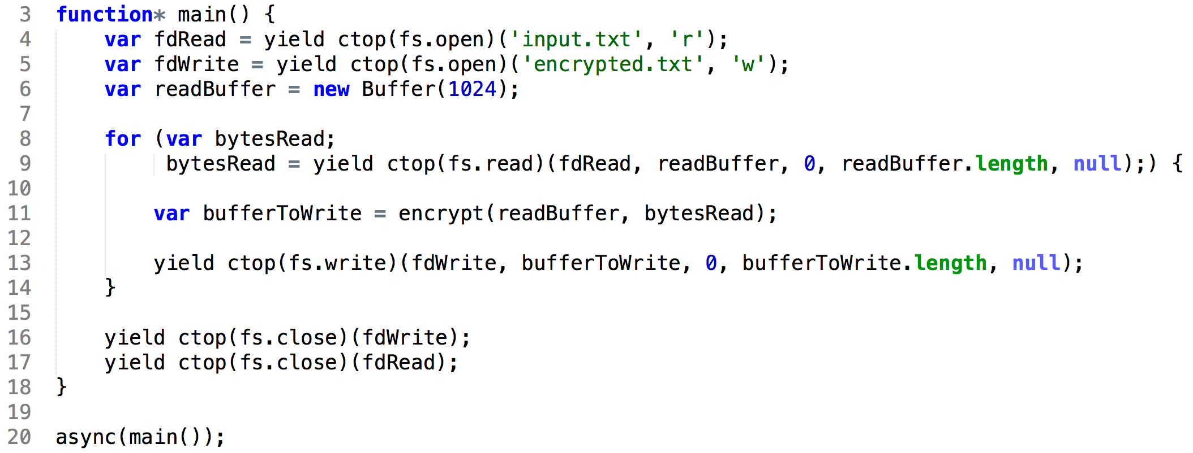
And… Async Heaven!

Slide 35
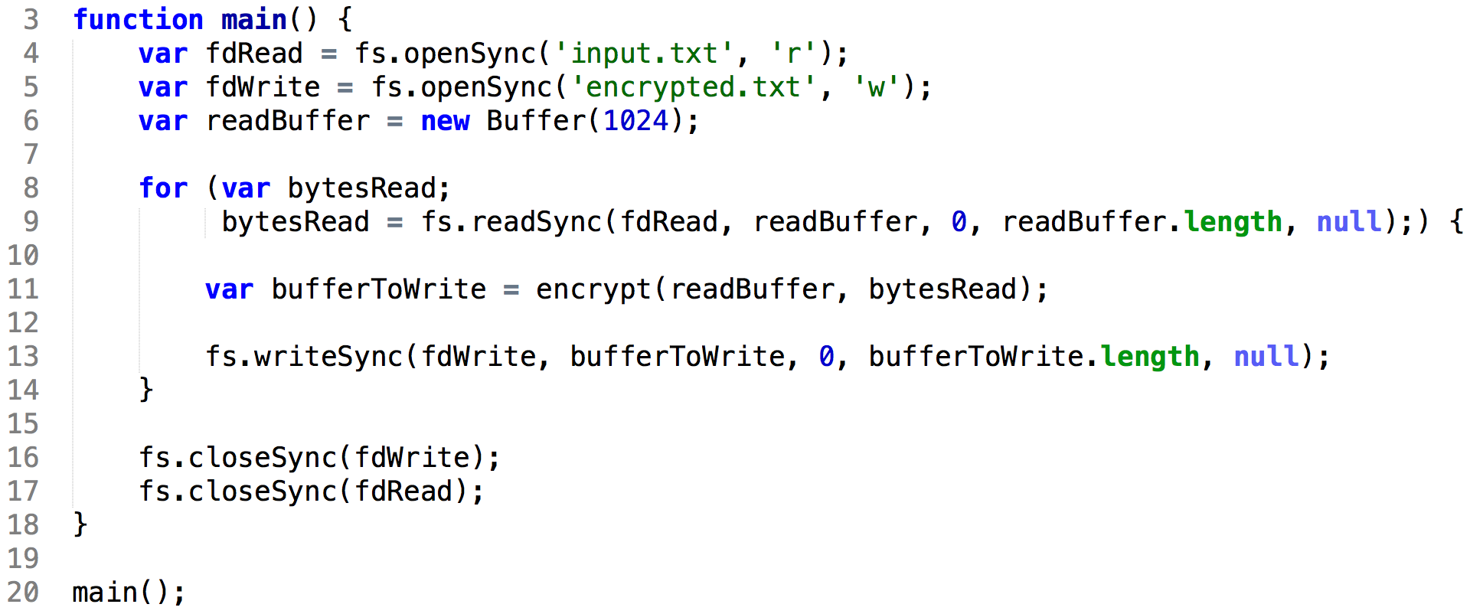
Compare

Slide 36
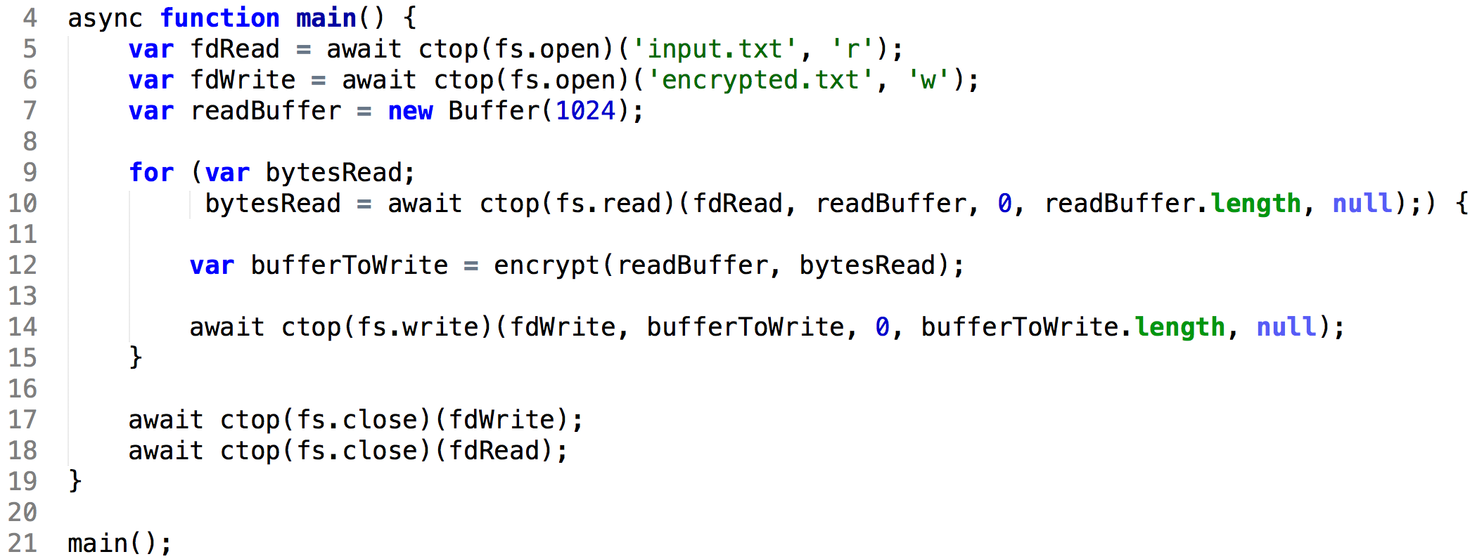
The Future
ES7!

Slide 37
So…

Slide 38

From Callback Hell

Slide 39

To Async Heaven

Slide 40
Our Journey is Complete
Thank You

